Slide 1
DIRUM
Database of Instruments for Resource Use Measurement

Slide 2
What is DIRUM?
DIRUM is an open-access database of resource-use questionnaires for use by health economists involved in trial-based economic evaluations
Funded by the Medical Research Council Network of Hubs for Trial Methodology Research, DIRUM also provides a repository of methodological papers related to resource use and cost measurement

Slide 3
Why do we need DIRUM?
Patient-reported resource use measures are with us for the foreseeable future
Well-respected tools are available, but not suitable for every circumstance
There are inefficiencies in the modifications / re-inventing of wheels which invariably happen without a central repository

Slide 4
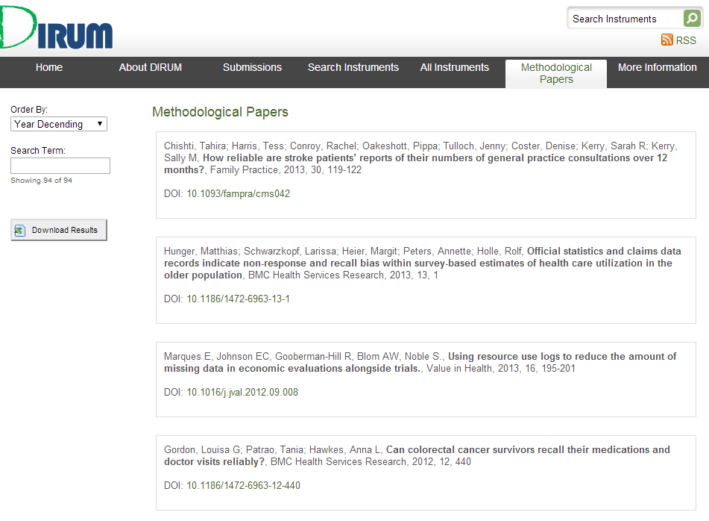
Methodological resource
Searchable list of 94 papers relating to the validity and reliability of resource use measures based on patient recall

Slide 5
5 steps to using DIRUM
Search DIRUM for relevant resource use measures when planning trial-based economic evaluations
There are 68 currently listed
Refer to DIRUM in research grant applications
DIRUM is signposted from Research Design Service websites
Include methodological development as part of the research
This might include piloting and tailoring of the resource use measure, or testing for validity or reliability
Upon completion of your study, submit your measure to DIRUM for inclusion in the database
Alert us to any methodological papers for listing

Slide 6
How can I contribute?
Submit a resource use
measure using the link

Slide 7
Related publications
Ridyard CH, Hughes DA; DIRUM Team. Taxonomy for methods of resource use measurement. Health Econ. 2014 Jan 20. doi: 10.1002/hec.3029
Ridyard CH, Hughes DA; DIRUM Team. Development of a database of instruments for resource-use measurement: purpose, feasibility, and design. Value Health. 2012 Jul-Aug;15(5):650-5. doi: 10.1016/j.jval.2012.03.004.
Thorn JC, Coast J, Cohen D, Hollingworth W, Knapp M, Noble SM, Ridyard C, Wordsworth S, Hughes D. Resource-use measurement based on patient recall: issues and challenges for economic evaluation. Appl Health Econ Health Policy. 2013 Jun;11(3):155-61. doi: 10.1007/s40258-013-0022-4.

Slide 8
Who is the DIRUM team?
Professor Dyfrig Hughes and Dr Colin Ridyard (Bangor University, NWHTMR)
Professor William Hollingworth, Dr Sian Noble and Dr Joanna Thorn (University of Bristol, ConDuCT)
Professor Joanna Coast (University of Birmingham)
Dr David Whitehurst (Simon Fraser University)
Professor Martin Knapp (London School of Economics and Political Science)
Contact us via: info@dirum.org

Slide 9
http://www.dirum.org/

